Slide 1

User Interface Design

Slide 2
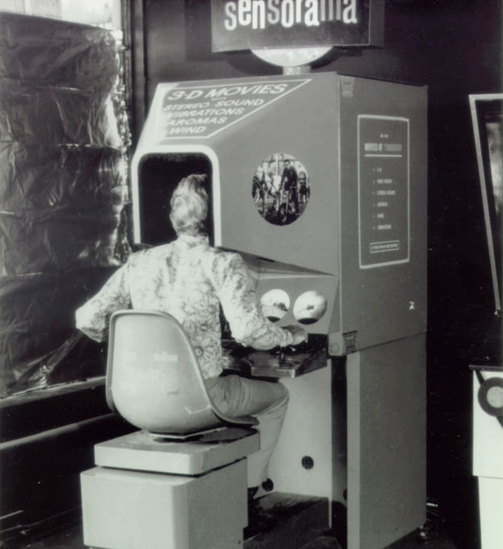

Interface Design
Initially users must adapt to complex systems
For being technical
Now technology must consider human ease
Usability matters a lot!!!!

Slide 3
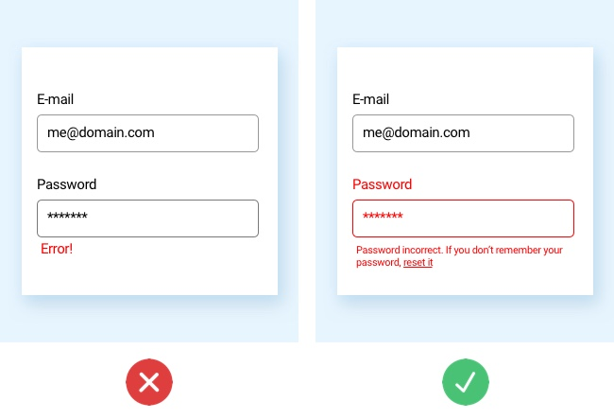
Interface Design
Set of golden rules defined
Interaction mechanism created
the window world
Issues observed in bad GUI designs:
Not user friendly
Confusing
Counterintuitive
frustrating

Slide 4
Golden rules for UI design (by Theo Mandel)
Place the user in control
1
Reduce user’s memory load
2
Make a consistent interface
3

Slide 5
Principle 1: Allow users to maintain control
Define interactive modes that allow the user to let them do whatever they want freely
Define different modes and allows easy switching between modes
E.g., spell check and editing modes in the word processor, read mode, browser modes, etc.
Allow flexible interaction
Allow users to interact via multiple ways like the mouse, keyboard, digitizer pen, voice inputs, multitouch inputs, etc.
Allow user interaction to be uninterruptable and undoable
Freely allows the user to quit a work and do another without losing changes
Undo/redo also allowed

Slide 6
Principle 1: Allow users to maintain control
Allow creating customized operations
Create macros for Frequently occurring operations(e.g., like in MS word)
For advanced users to customize UI
Hide technical internals from casual users
User is unaware of the underlying OS, file management operations and other complexities
E.g., in Application software, there is no need to give OS commands.
Design for direct interaction with on-screen objects
Icons or other objects could be dragged or scaled up or down as if they exist physically.

Slide 7
Principle 2: Reduce User’s memory load
Well designed system doesn’t test user’s memory
E.g., Use list boxes or checkbox inputs rather than text boxes.
Reduce demand to learn more
Users should not have to recall past inputs, rather they are saved and shown using visuals.
Establish meaningful defaults
User should have a preference to customize layout or change the default settings.
However, reset could change them to defaults again.

Slide 8
Principle 2: Reduce User’s memory load
Define intuitive shortcuts
Bind shortcuts that are easy to remember like ctrl+p for print
Visual layout should be near to real-time systems
E.g., the bill paying process should be the same as in real life.
All steps must be fulfilled.
Disclose information in a progressive fashion
Information displayed on multiple levels.
E.g., E-commerce websites have just pictures. Click that to show detailed information, different underline options shown when clicked on the list further

Slide 9
Principle 3: Make consistent interface
Allow users to put tasks in meaningful context
User should have an idea of the work they are doing
Like windows should be labeled with titles, consistent color coding should be used for the same tasks etc.
Maintain consistency across a family of applications
A set of applications must follow a particular pattern
As the front and the back view is same in whole MS office.
Don’t make changes in system against user’s previous habits, until you are compelled to do so
Don’t redefine the user’s past experiences in UI
For example, Ctrl+S is used for save. Don’t bind it with scaling. As user is expecting on his past experience that it’ll save the file.

Slide 10
UI Analysis & design
Segregate human-oriented and computer-oriented tasks
Think of design issues for UI design
Tools are used to prototype
Implement design model
Users evaluate the design quality

Slide 11
UI Design models
User model
Design model
System perception/mental model
Implementation model
Analyze all end user profile
Like age, gender, physical abilities, education, culture, preferences etc.
User types:
Novice
Knowledgeable, intermittent users
Knowledgeable, frequent users
Design realization of end user’s model
End user’s perspective of a system
The interface look & feel along with supporting information (books, manuals, videotapes etc.) showing interface semantics.

Slide 12
UI Design models
Hence, an effective design is one in which the user mental model and implementation model coincides

Slide 13
UI analysis & design Process
Iterative process ~ use spiral process model
Four steps are:
Interface analysis & modeling
Interface design
Interface construction ~ involve prototyping approach
Interface validation
Since its spiral model so these steps need to be processed again and again

Slide 14
What is a good Design?
You need to design an application that shows the video of the security cameras in the home
Options???
A user must input the camera name to view the video
What if he forgets the name?
We will list the cameras name from which he selects and view the video

